Slide 1

SUB ASSEMBLY PROCESS IMPROVEMENT
Expansion Proposal Business Process Improvement

Slide 2
Areas of improvement
Current Process with gaps draft:
Production costs for different versions of sub assemblies due to part costs e.g KP door lock V1 is cheaper than V2.
Verification of requested parts from store according BOM is a manual process which is time consuming.
Duplicate serials for parts tracked.
Quality of tools e.g wire stripper.
Partial sub assemblies.
Reduction of components in the dispense column.

Slide 3
Areas of improvement
Improvement area 1:
Production cost due to part costs for example production of KP door locks whereby V1(custom made when bought in bulk) is cheaper than V2 the cost of buying parts by 1.112 USD per lock.
DfMA-Time taken to assemble (soldering) V2.
Soldering also is a safety risk for long term exposure.
Solution/Proposal:
Review the costs of different versions of sub assemblies here sub assembly detailed structure so as to reduce the production cost.
Time taken to produce V1 also is less than V2 hence reducing time taken by half (6mins saved per lock)
Part Name | Qty | Unit | Cost In USD | Bulk Purchase Cost(1000 pcs)
[KA10] DOOR LOCK SETUP V1 Assembled Cost | 1 | Pieces | 16.925 | 16.925x1000 | USD 16925
[KPR120] MINI-FIT JR. 5556 SERIES CONTACTS | 4 | Pieces | 0.038
[KPR40] 4 POLE MOLEX MINI-FIT | 1 | Pieces | 0.087
[KPR73] ELECTRIC BOLT LOCK (15CM CABLE) | 1 | Pieces | 16.8

Slide 4
Cont.
Part Name | Qty | Unit | Cost In USD | Bulk Purchase Cost(1000 pcs)
K115 KP Door Lock_V2 setup Assembled Cost | 1 | Pieces | 18.037 | 18.037x 1000 | 18037 USD
[KPR168] 4 WIRE SHIELDED CABLE 24AWG | 0.8 | Meters | 0.903
[KPR150] PRO POWER HEAT SHRINK TUBING 5MM BLACK(100M) | 0.06 | Meters | 0.209
[KPR120] MINI-FIT JR. 5556 SERIES CONTACTS | 4 | Pieces | 0.038
[KPR40] 4 POLE MOLEX MINI-FIT | 1 | Pieces | 0.087
[KPR72] ELECTRIC BOLT LOCK (15CM CABLE) | 1 | Pieces | 16.8
[KPR136] SOLDER (1MM) | 2.6 | Grams | 0
Compare V1 Mass Assembly cost and V 2 Mass Assembly cost = Savings = 18037-16925 = USD 1112
NB :Labor cost and time not factored V1 assembly Savings time 6 min / unit and involves less components

Slide 5
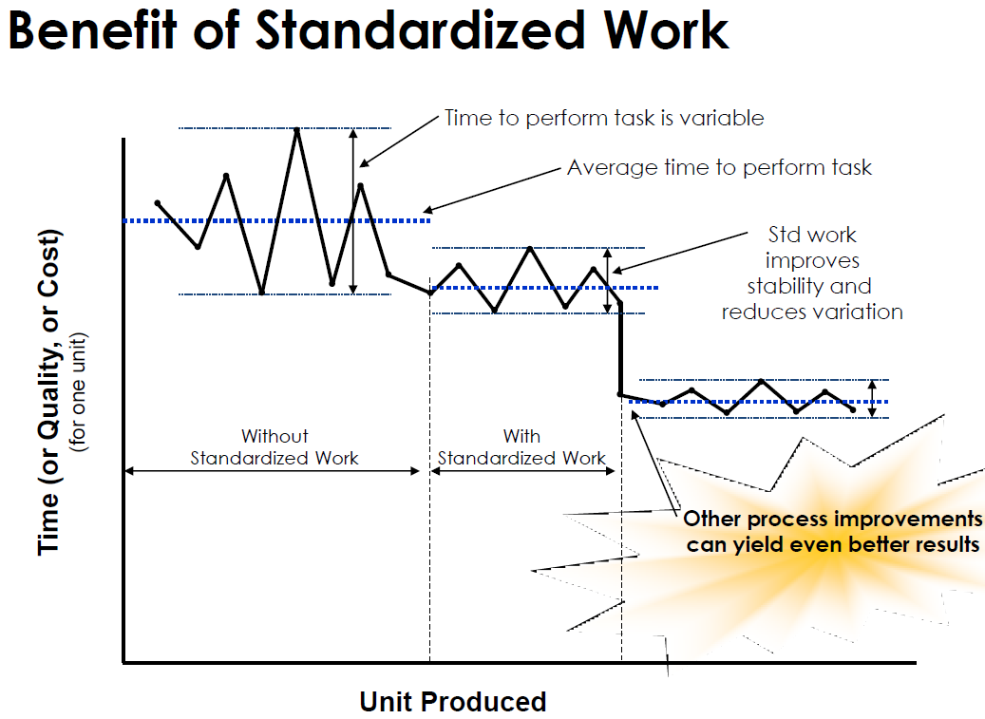

Slide 6
Verification of requested parts from store
Improvement area 2:
Verification of requested parts from store according BOM is a manual process which is time consuming.
Solution:
Use of QR code scanners/barcode scanners, this would lead to increased efficiency.
Cycle time for a particular sub assembly would also be reduced by more than 5 minutes.
Savings = labor cost /unit time
Improvement area 3:
Duplicate serials for parts tracked at sub assembly level.
Cause:
Hand written serialization and recording in manual sheets.
Solution: Use of QR/Barcode scanner

Slide 7
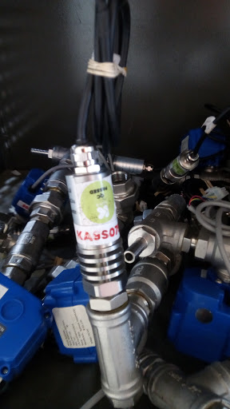
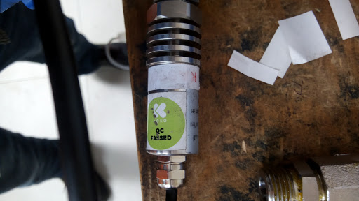
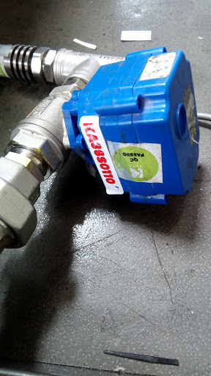
Unrecognizable/Worn out serials due to loctite & Ethanol

Slide 8
Areas of improvement cont.
Improvement area 4:
Quality of tools- a number of tools for example wire stripper was of poor quality hence lead to poor quality of goods produced.
Solution:
Better tools recommended here Tools BOM.
Improvement area 5:
Partial sub assemblies hence leading to confusion in material request (no BOM for part assemblies)
Cause:
This is due to delay of parts from suppliers
Solution:
Timely delivery of materials or BOM created for partial assembly.

Slide 9
Hose cutting Tool research
Alternate hose cutting tool to enhance safety of personnel doing the task
Link 1
Link 2

Slide 10
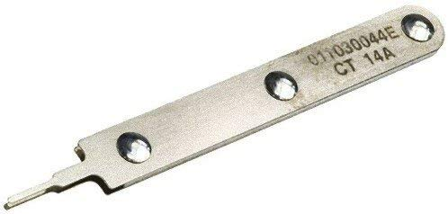
Molex extraction tool
Link
This would reduce on wastes of molex minifit assembled in wrong configuration

Slide 11
Areas of improvement cont.
Improvement area 6:
Change orientation of dispense column to use manual ball valve(male -female) immediately after the tank nipple to act as an isolator.
This would eventually reduce one nipple in the column.
Total saving of 713x1.035=738 USD for mass assembly.
Use of BSPT fittings unlike the current BSPP ones which sealing is an issue.
Effect:
This would reduce cost of maintenance emptying the whole tank so as to repair the dispense column.
See photo next slide
[KPR5] 1/2" HEX NIPPLE -BSPP | 1 | Unit | 1.035

Slide 12
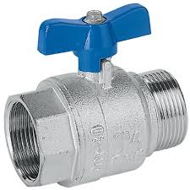
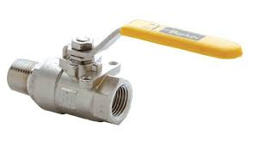
Male female manual ball valve
The male female manual ball valve to act as tank isolator

